Slide 1


Working With Schools

Slide 2

Four Training Resources
IDRC has developed a four-part training series that covers each of the four areas of Balanced Recruitment.
Use the resources to review your current efforts and see if there are any additional areas that you can expand your ID&R efforts.

Slide 3
What is Balanced Recruitment?
For MEP programs to be successful it is necessary to ensure that all areas of the state are thoroughly canvassed through Balanced Recruitment Efforts.
This involves covering housing, working to recruit in the community and develop partnerships with community agencies, developing partnerships with farms, fisheries, and agribusinesses, and working with schools.

Slide 4
What is Balanced Recruitment?
Community Recruitment
Housing
Farms, Fishing, Agribusiness
Schools
All four areas are essential to developing successful Identification and Recruitment Efforts.

Slide 5

What this training covers…
Why school-based recruitment is important.
How to identify all schools and staff who can help.
How to build relationships that lead to referrals.
How to organize your information and identify the best ways to do outreach.

Slide 6
Schools are an invaluable resource for MEP
All MEP programs should be developing a multi level approach in order to work well with all school districts in their state.
This approach should include state level, district level, and how the recruiter should work with the schools.
State Level
District Level
Recruiter Level

Slide 7

From the State Level- Best Practices
State Directors should actively be working to develop partnerships with the schools from the top down.
Superintendents should all be aware of the MEP program
Title I Directors also should be aware and informed of what the program entails, and its responsibilities related to Title I.

Slide 8
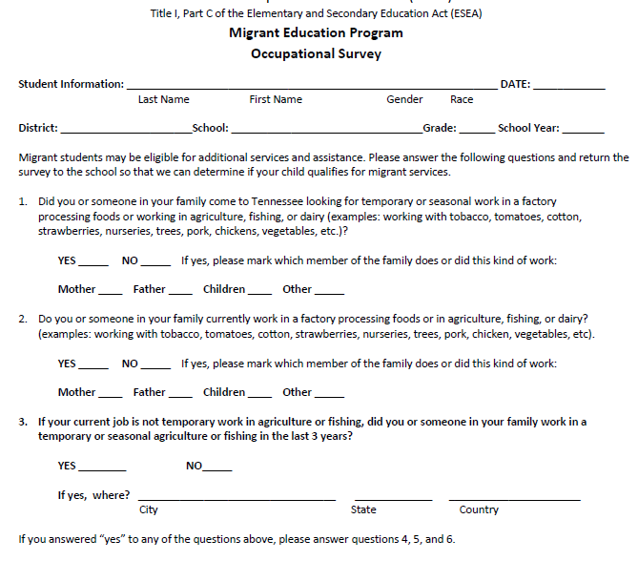
From the State Level- Best Practices
A survey should be developed at the state to be given to all NEWLY enrolled students into the district.
This survey should be a requirement for all districts in the state.

Slide 9
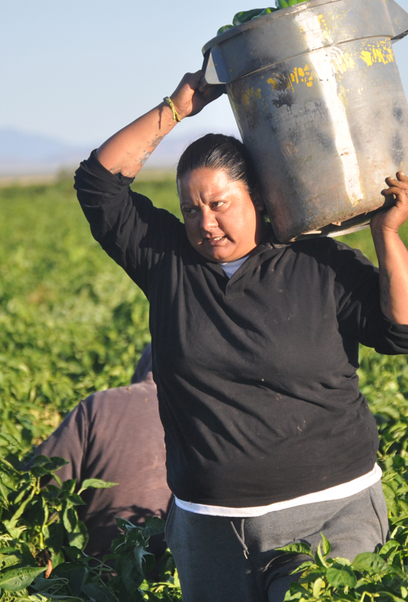
Developing the Survey
This survey should help identify children who have moved recently with a migratory agricultural worker.
State staff should determine the best way to ensure that all districts are filling out the survey and if any of the questions are marked yes that they are returned to the MEP program.

Slide 10

Developing the Survey
State staff should work to ensure that this survey is not cumbersome in its nature in that all students are filling it out when that is not necessary.
A full process should be developed to determine the best way to ensure that all newly enrolled students to a district are able to take the survey.

Slide 11

From the state level-
Best Practices
It can be helpful to have an assigned Migrant Liaison (like a McKinney Vento Liaison) at each district.
This person would be assigned even if the district is not receiving MEP funding.

Slide 12

From the state level- Best Practices
These personnel should be trained on the MEP and on eligibility requirements. In addition, they should be trained on what to do when a MEP child is identified.
Make sure the districts know what is available to MEP children even if there is no funding in the district through MEP such as free lunch.

Slide 13

From the state level down
It can be helpful to have a yearly training for all districts in coordination with another state training to ensure that all districts are aware of the program and any responsibilities they may have even if they do not get funding.

Slide 14
From the state level down
All Migrant Liaisons can be invited to attend the meeting.
In addition, ELL program directors, attendance staff, and principals are also ideal to invite to a meeting to learn more about MEP.
McKinney Vento staff would also benefit from being invited to attend.

Slide 15
Ensure all students are identified in the state
MEP programs should be extremely thorough in their approach to finding eligible migrant students and schools are an important part of this process.
Don’t assume some districts don’t have any MEP students. Make sure you know by ensuring all schools are filling out needed surveys, have a MEP liaison who is aware of the eligibility requirements, and that all superintendents are also aware of MEP.

Slide 16

What to do with the surveys!
Once you get surveys in there should be an organized process to follow up with each potential one as soon as possible.
It also can be helpful to contact the schools after you can determine if students are eligible or not to report back on the results.
Then can ensure they see that the work in gathering the forms is well worth it due to the results they see of what happens once the MEP program receives those forms.

Slide 17

Market Your Program
It can be helpful to send a newsletter outlining what the MEP is offering to students across the state periodically as a reminder to superintendents and principals.
This newsletter could include highlights of students who have benefited greatly from the program, staff comments on their thoughts about the benefits of the program as well as some updates of identification and recruitment efforts in the state.

Slide 18

Market Your Program
It is helpful to get the word out about the program in many ways. This can be through direct face to face contact, emails, zoom calls, trainings, fliers, brochures, etc.

Slide 19
Local Level
Local school district staff should know the local recruiter and or MEP project director.
MEP staff also should build relationships with attendance staff, school secretaries, English Language teachers, etc.
A relationship can be built between both groups that mutually benefits MEP students.

Slide 20

Local Level
It is also helpful if services are provided outside of the local school district by MEP that they know what the program is providing to the students.
Sometimes MEP can hold a very valuable spot being a liaison between the MEP family and the school. MEP programs should work to build that relationship.

Slide 21

Mobility Data
Work with your local school district to know where kids are moving in and out the most.
Districts keep data on which of their schools have the most students moving in and out.
This is helpful to obtain because often the housing zoned in this schools' boundaries will be good places to canvass due to the movement in and out of families.

Slide 22

Other Programs to partner with
Schools often offer lots of extra programs migrant families might not be aware of.
These can include afterschool tutoring, resources through the McKinney Vento Program, counseling and career planning, pre-K programs, etc.
MEP staff should get to know all of these types of resources to be able to share these with families.
This may be easier when recruiters are housed within districts. When they are not all efforts should be made just the same to build these relationships.

Slide 23

Share Needs with the Schools
If you are working with MEP students and their families and they have needs the schools should be aware of, make sure to share those.
Working together you will be able to help make a greater impact for the student.
Schools should see the MEP as a direct ally in the effort to help serve migrant students.

Slide 24

School Meetings
Make sure MEP is not taking over the jobs of the local school district staff (becoming the school translator, etc.) but MEP staff are often able to help families understand the complex school meetings to ensure that parents can advocate for their children.

Slide 25

School Meetings
It can be very helpful to get permission to set up a table at registration nights and family and parent events to help get the word out about the program.
Be strategic also with getting the word out through fliers and posters in key places that students or parents wait in or pass through often.

